Slide 2
ClusterAPI
Yang Yu
VMware

Slide 3
Agenda
Memory lane
Kubernetes bootstrapping & provisioning
ClusterAPI
Demo
Roadmap
ClusterAPI and you

Slide 4
What is a Kubernetes Cluster?
Infrastructure
Networking
Firewall Rules
Servers
Load balancer
Kubernetes components
Add-ons
Disaster recovery (Velero)
Ingress (Contour, Gimbal)
Registry (Harbor)
Conformance (Sonobuoy)
User Apps

Slide 5
Kubernetes Components
Container runtime
kubelet
etcd
kube-apiserver
kube-scheduler
kube-controller-manager
kube-proxy
CNI provider
CoreDNS

Slide 6
Bootstrapping?
Container runtime
kubelet
etcd
kube-apiserver
kube-scheduler
kube-controller-manager
kube-proxy
CNI provider
CoreDNS
???????

Slide 7
kubeadm
Consistent Kubernetes cluster bootstrapping

Slide 8
kubeadm
Owned by SIG Cluster Lifecycle
Provides a consistent cluster bootstrapping experience
Declarative configuration model (InitConfiguration, ClusterConfiguration, JoinConfiguration)
kubeadm init: create a new control plane node
kubeadm join: join a new control plane or worker node
Building block for higher-level systems
Does not handle infrastructure

Slide 9
Kubernetes Cluster: Provisioning?
Infrastructure
Networking
Firewall Rules
Servers
Load balancer
Kubernetes components
Add-ons
Disaster recovery (Velero)
Ingress (Contour, Gimbal)
Registry (Harbor)
Conformance (Sonobuoy)
User Apps
???????

Slide 10
Kubernetes in Layers
Add-ons
Ecosystem
Cloud Integrations
Runtime: Kubernetes
Bootstrapping: kubeadm
Provisioning: ClusterAPI
API Driven Infrastructure

Slide 11
Cluster API
Declarative lifecycle management of Kubernetes Clusters
Notes:
The ClusterAPI is a Kubernetes project to bring declarative, Kubernetes-style APIs to cluster creation, configuration, and management.

Slide 12
ClusterAPI
Declarative lifecycle management of Kubernetes clusters
Create, Scale, Upgrade, Delete
github.com/kubernetes-sigs/cluster-api
Subproject of SIG Cluster Lifecycle
Community discussions started September 2017
Kubernetes Enhancement Proposal (KEP)
12 SIG sponsored infrastructure provider implementations
Initial v1alpha1 release March 29, 2019
Building block for higher-level systems

Slide 13
ClusterAPI
VMware
Pivotal
SUSE
Google
NetApp
SAP
The Scale Factory
Mesosphere
Red Hat
Weaveworks
New Relic
Amazon AWS
Samsung
Loodse
Platform9
Microsoft

Slide 14
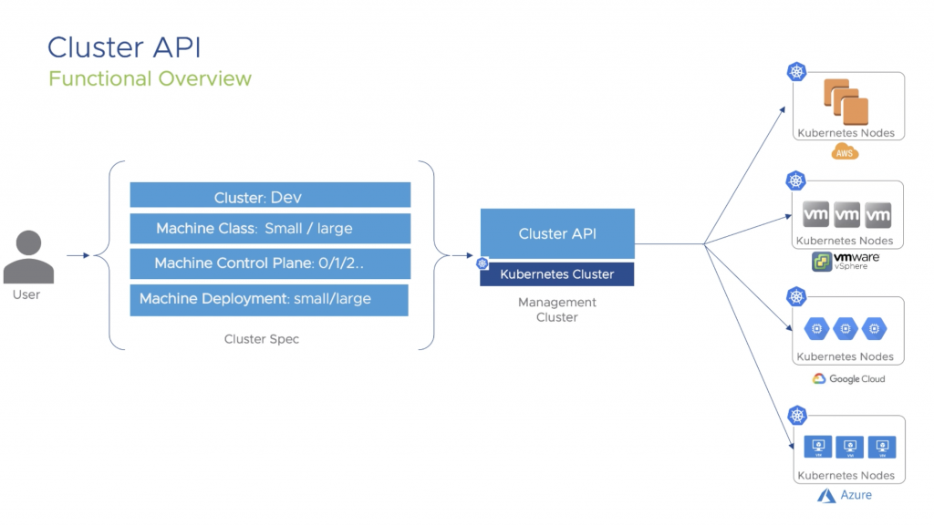
ClusterAPI

Slide 15
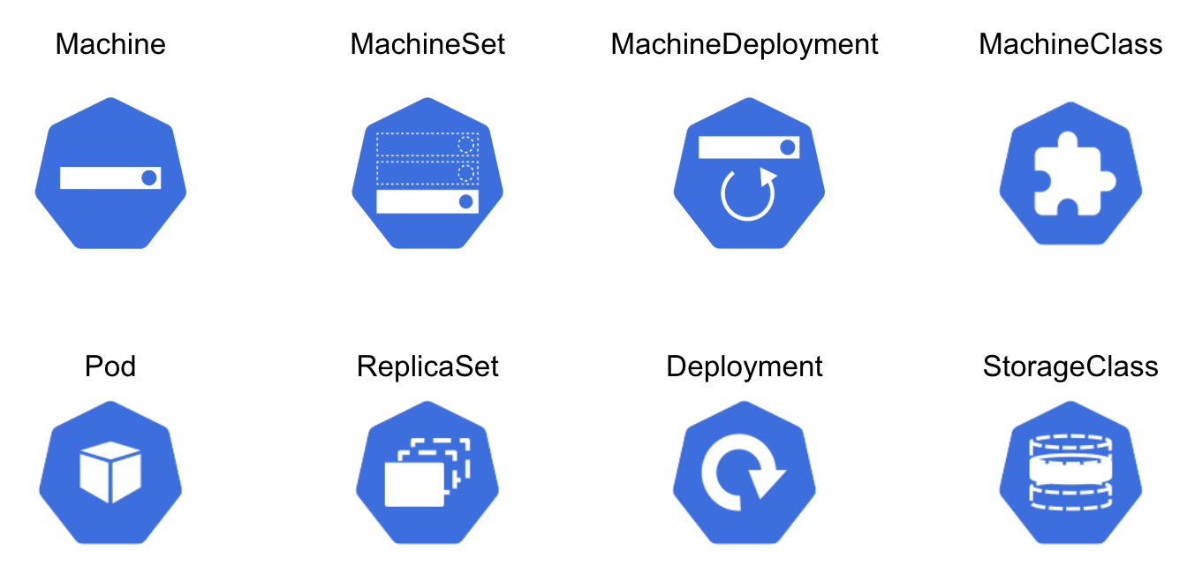
ClusterAPI

Slide 16
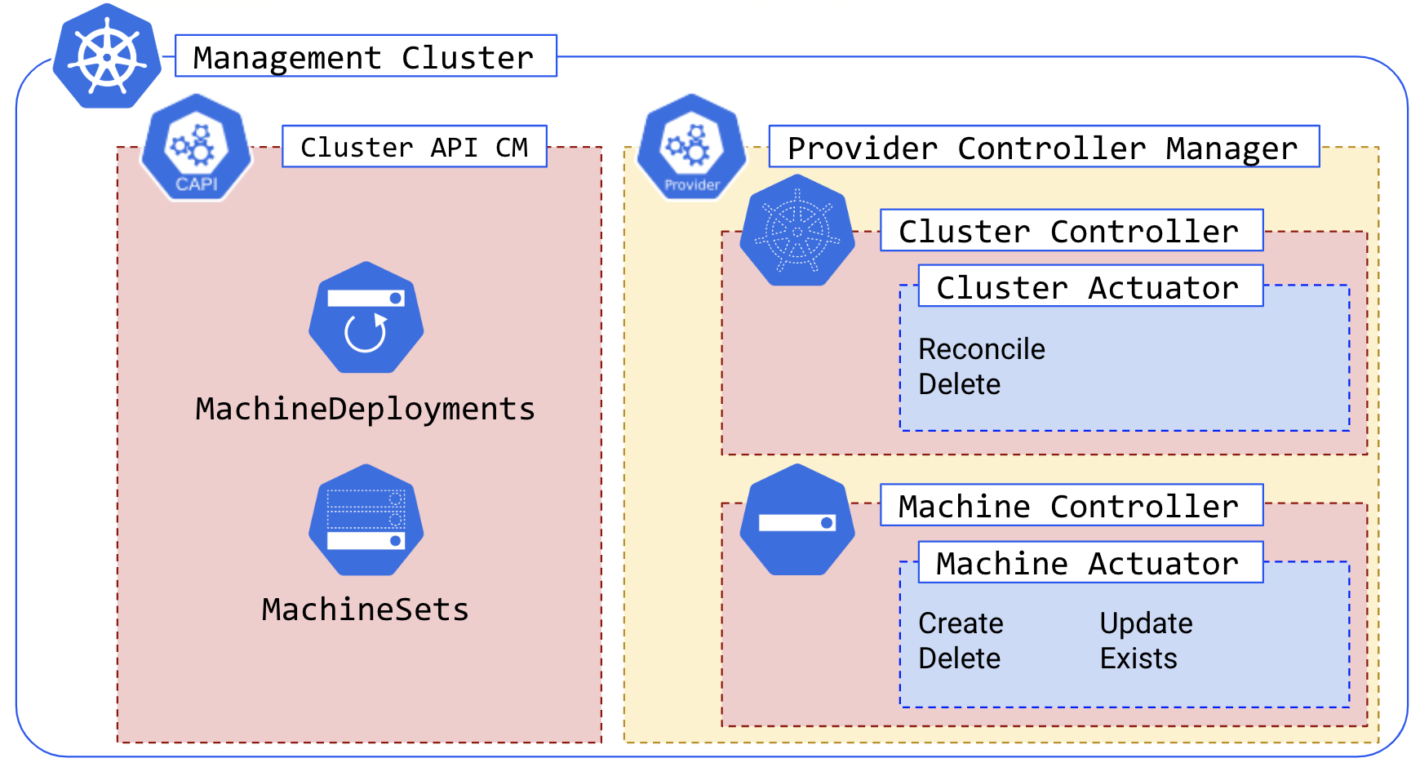
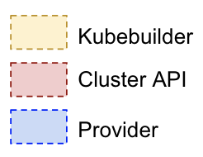
ClusterAPI

Slide 17
Cluster Creation
Management Cluster
Install CRDs, controllers, actuators into management cluster
Create objects
Cluster
Machine(s) for the control plane
Add-ons (CNI)
MachineDeployment(s) for worker nodes
CAPI creates infrastructure & bootstraps target cluster
Cluster API Controllers
Cluster A
Cluster B
Cluster
Cluster
Control plane Machines
Control plane Machines
MachineDeployments
MachineDeployments
Networking
Networking
Firewall Rules
Firewall Rules
Load Balancer
Load Balancer
VMs
VMs

Slide 18
Cluster Creation
Start with “bootstrap” cluster (kind)
Install CRDs, controllers, actuators into bootstrap cluster
Create objects (cluster, machine, etc.)
Creates infrastructure & bootstraps target cluster
Copy Cluster API & objects into target cluster
Delete kind bootstrap cluster
Use target cluster for all future management

Slide 19
Demo!

Slide 20
ClusterAPI Roadmap

Slide 21
Long term priorities
Refining architecture to share cluster bootstrapping logic across infrastructure providers
Focusing on node and control plane lifecycle management, including upgrades
Working on common tooling to create VM images for multiple infrastructure providers
Extension Mechanisms

Slide 22
Project governance
Release cadence
Reduce scope to iterate faster
4 releases per year
~6 weeks after each Kubernetes minor release
v1alpha2 tentatively set for August
Backlog prioritization proposal
Communication & collaboration through KEPs, improved meeting etiquette
Many alphas & betas until APIs stabilize (similar to how we handled kubeadm)
Underlying controllers can be robust, though!

Slide 23
Proposed v1alpha2 scope
Data Model - P0
Machine states and bootstrapping
Remote node references
Control plane lifecycle management
Upgrades - P1
For ClusterAPI itself
For clusters provisioned by ClusterAPI
Status - P2
Health reporting
Progress reporting
Security - P3
Certificate storage

Slide 24
Cluster API and You

Slide 25

How to get involved
Try it out!
Join our mirror sig and/or community meetings
File bugs
Add feature requests
Submit pull requests

Slide 26
Links
SIG Cluster Lifecycle
Cluster API (CAPI)
Project Meeting Minutes
Community Forum
Scope & Objectives
Use Cases
Extension Mechanism
Data Model
Control Plane Lifecycle Management
Node Lifecycle Management
AWS Provider (CAPA)
vSphere Provider (CAPV)
Azure Provider (CAPZ)

